Slide 1
IPS Corporation
IT Overview - 2025
David Mushinskie
CIO & CISO

Slide 2

Digital Transformation Strategy
Maximize technology assets to drive business value and minimize risk

Slide 3

















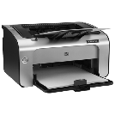




Linking the Business and IT
CVDs and Business Strategies from SD provide vision and initiatives.
Business Processes, Standard Work and Forums provide a view of how the OpCo and functions will operate, both now and in the future.
Information & Analytics represents what must be “known” to effectively understand, execute, and improve the processes and make decisions
Applications & Data are the tools that enable the business processes to deliver information
The IT Infrastructure enables access to applications & data
Cybersecurity ensure a safe and secure operating environment
CVDs & Business Strategies
Business Process & Forums
Information & Analytics
Applications & Data
IT Infrastructure
Cybersecurity

Slide 4
IT Strategic Plan Pillars
“Front-End” Commercial Operations
Technical Debt Elimination
Oracle JD Edwards ERP,
Unsupported HW and SW
Salesforce.com Platform
IPS Connect Customer & Partner Portal
EDI
eCommerce
“Back-End” Business Operations
Vulnerability Remediation
One Stream
Cognos & legacy Data Warehouse
Cleo Integration
DSI & Scanner
ERP Bolt-On’s
IT Organizational Transformation
Project & Change Mgmt, Business Analysis/Partnership, Outsourced Managed Service

Slide 5
The Components of our IT ecoSystem
APPLICATION
Commercial Solutions
Operational Solutions
Business Intelligence & Analytics
Desktop Solutions
Collaboration Solutions
Enables seamless touch points between IPS & it’s business partners
(e.g., EDI, eCommerce, IPS Connect, Salesforce.com)
Support the ongoing operations of the business
(e.g., JDEdwards E1 ERP, DSI, Bartender)
Enable individual and/or group productivity
(e.g., M365, Teams, OneDrive, Shop Floor systems)
Establishes workforce collaboration and access to information
(e.g., Email, MyIPS Intranet, SharePoint, Teams)
Monitor, Manage, and Optimize Business Performance
(e.g., Cognos, Insight Hubble, OneStream)
DATA Management & Privacy
IT INFRASTRUCTURE
Private Cloud Data Center
(FNTS)
Network
(CATO Networks, Airespring & GTT)
Site Infrastructure
& Desktop
Telephony/VoIP & Mobile Devices
(Ring Central)
CYBERSECURITY

Slide 6

























Application Overview as of October 2025
Commercial
Manufacturing, D&L
Order Mgmt, Finance
BI & Reporting
Excel Input/FTP
Customer Portal
Enterprise Data Warehouse & ETL/SSIS
v2016
BI Visualization & Distribution
Sales & Service, Marketing, Experience Cloud
Geo Location/
Address
MS Access
MS Excel
EDI Orders
Excel
Orchestrator
Adhoc ERP Reporting
Shop Floor Scanner
Label Printing
Consolidated Financials
Product Information Mgmt System
Document Mgmt.
Credit Card Processing
HRIS
Legacy Standalone ERPs
WT ProVent ERP
Sales & Monthly GL

Slide 7











Infrastructure Overview
Data Center
  FNTS hosted Private Cloud and Managed Service Provider
    IBM iSeries AS400 P9/10, VMWare virtualized Windows servers, MS SQL Servers
    File and Print, Domain Controller
    Integrated Disaster Recovery FNTS Data Center
  Small on-premise infrastructure footprint
Network
  CATO Networks WAN backbone
  Airespring & GTT primary internet circuits deployed globally, secondary circuits at critical sites
  24x7 outsourced managed service with secure SDWAN solution from CATO Networks
Desktop
  M365 (Email, OneDrive, Teams/SharePoint) and Azure Active Directory in Cloud
  Lenovo PC and laptop standard, MS Windows v11 OS
  Ring Central VoIP and Customer Svc Contact Center
  Verizon and AT&T – US mobile standard

Slide 8

















IPS Cybersecurity Journey
OT Risk Management
Initial OT Risk Assessment
Remediation Planning and implementation
Assign OT asset status & criticality in CrowdStrike for networked OT
Advance Cybersecurity Maturity
Mobile Device Management Policy
Supply Chain Risk Management Policy
M&A Risk Assessment Framework
Text Spoofing Prevention Policy
Increased User Education/Social Engineering
Physical Site Testing
Establish IPS Security Forum
Expand Foundational Policies
Cybersecurity Governance
Access Control
Vulnerability Management
IT Asset Management
Security Awareness & Training
Monitoring & Logging
Acceptable Use
Protect Network & Apps
AI Management
AI Policy
Monitor AI Use
Assess AI Security Posture
Perimeter Security
Respond & Recovery
Protect End Points
2020
2024
2025
2026
2027+
PEN Test & AUDIT
PEN Test & AUDIT
PEN Test
Simulated Attack Tabletop Exercise
PEN Test & CSF AUDIT
PEN Test
Protect & Manage Data
Data Privacy & Management Policy
Categorize/Classify Data
Retention & Archive
Data Loss Prevention (DLP)
Encrypt Data in Motion & Data at Rest
Review User Permissions to Sensitive & Proprietary Data
Improved Threat & Vulnerability Monitoring
Audit User & Privileged Accounts
SIEM/Log Analysis Improvements
Annual Disaster Recovery Test
Annual OT Risk Assessment
Cybersecurity Operational Improvements
Annual NIST CSF Audit & Penetration Test
Annual OT Risk Assessment
Annual Disaster Recovery Test
Annual Cybersecurity Policy Review & Update
Remediation Planning and Implementation
Cyber Risk Assessment & Training
Managed Detection & Response
Identity & Access Mgmt
IPS Cybersecurity Team
Threat and Vulnerability Monitoring
Process, Forum, Tool Established

Slide 9

IPS Cybersecurity Awareness Program
New Employee Cybersecurity onboard Training
Quarterly Training Cycle
Month 1 – Training video
Month 2 – Phishing Test
Month 3 – Re-Test for any failures
Phish Alert Report in eMail
For suspected security incidents or any questions, email to cybersecurity@ipscorp.com

Slide 10

Organizational Strategy & Service Model
Improve customer service, establish business partnership and grow internal capabilities

Slide 11
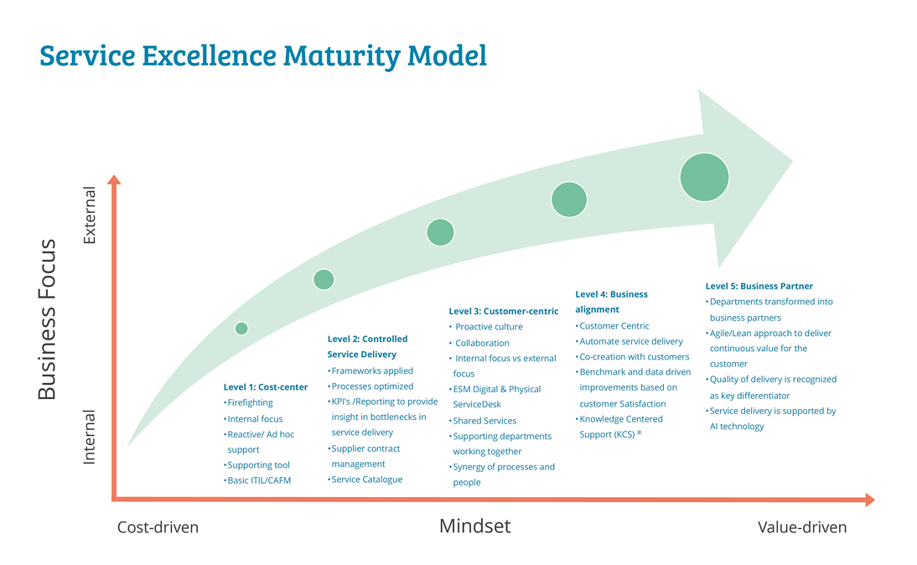
Our Shared Services Journey
Prior to 2021
2022-23
2024-2025
2026
2027+
IPS IT Service Maturity Timeline

Slide 12
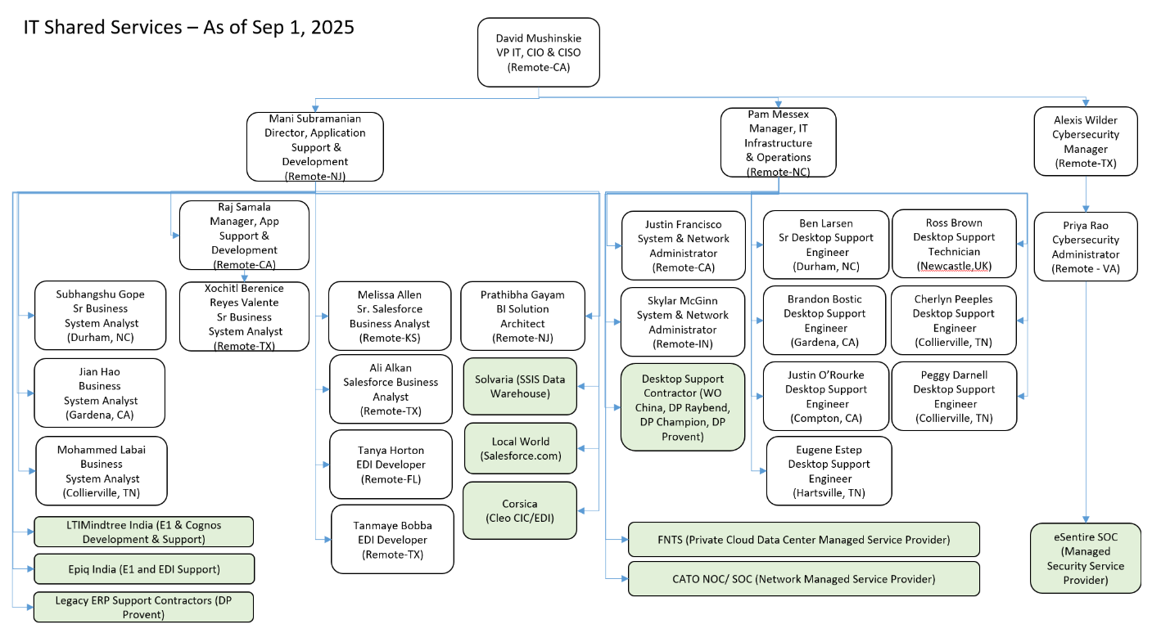
Organizational Chart

Slide 13




IT Demand Management
IT Service Delivery model will support four main inputs of demand
BREAK/FIX INCIDENT
IT system(s) not available or working as designed. Production operations are down or degraded
SERVICE REQUEST
Ticket routed to appropriate IT technical support team for completion of service
CHANGE REQUEST
Requests for application enhancement due to business process change, new functionality, new report, etc.
PROJECTS
Technology enabled Projects requiring
> 160 hours of IT work
Prioritized and Approved by Head of IT and the OpCo Presidents prior to work beginning
High/Med/Low priority assigned based on impact to IPS operations. Ticket routed to appropriate IT support team for initial triage
Request for routine service or maintenance
Routine = Output from an Action Plan/Kaizen/SD with previous IT involvement
Non Routine = Approval Needed
Enterprise-wide impact
Entire OpCo or Plant(s)
An entire business function/dept
User
Critical
Prioritization
Low
Notes:
[Dave Mushinskie]
Notes from phone call:
There is a macro umbrella prod support that IT provides:
Break/Fix or Incident Management (Help Desk & routes to approp team)
Application Enhancement (Works, but we want it changed or something new). BI is one of the systems that would fall into this category.
Projects - Bigger than a breadbox. We measure it in terms of hours (more than 160 hours of work - a man month).
BI and Data fall into these buckets (as in a new regular report or adding an item).
We have in IT a methodology for how these three buckets work (how we govern those 3 processes).
What we don't have is the data process.
If data is broken, what do we do?
Stewardship - something Bill and Alan will have to put together.

Slide 14


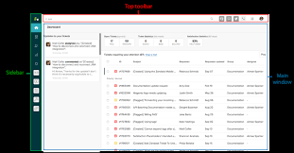
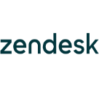


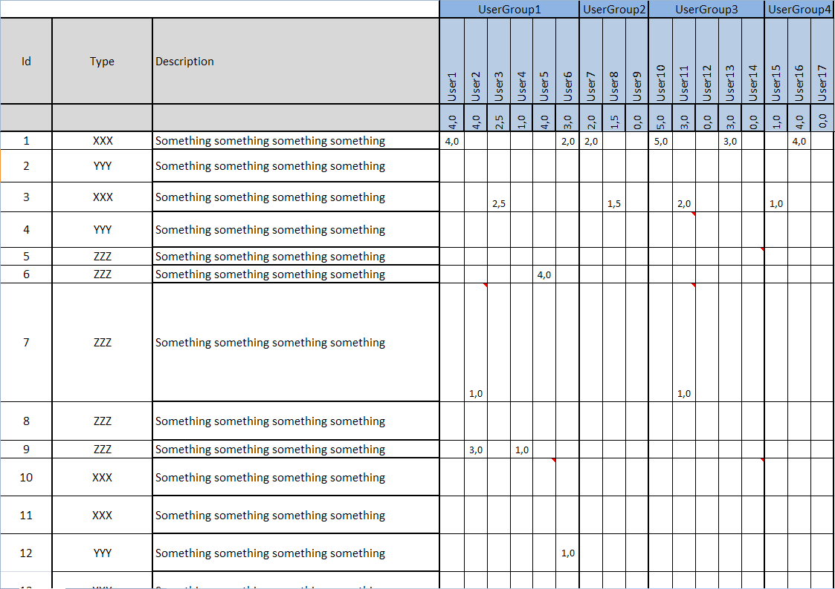
IT Service Delivery Model
Zendesk ‘Help Desk’ ticketing system contains all details and history from Open to Close
New Project
IT Support
Ticket System
Zendesk IT Support Form
BREAK/FIX INCIDENT
SERVICE REQUEST
APPLICATION CHANGE REQUEST
PROJECT
CIO
IPS Governance CAB
Approved
Dir, IT Apps
IT Technical CAB
Ticket System
Prioritization
& Assignment
Approved
IT Project Portfolio Backlog Review
Ticket Status
Open : IT actively working on it.
Pending : Waiting for third party – User approval, IPS Governance CAB approval, response from user etc.
On-Hold : Waiting for IT resource assignment
Solved : Completed
Scope Document
Functional Design Document
OpCo President Approval
IT Shared Services
IT Infrastructure & Operations Team
Hardware, Network & Telephony
Desktop Support
Cybersecurity Team
Cybersecurity Incidents
Risk Management
Applications, EDI, and BI/Data Team
Technical Design and Build
Unit & System Testing
Production Deployment

Slide 15
IT Service Escalation Process – CRITICAL Issues
  System Escalation Process Standard Work
  S.O.P. 15.13 System Related Issue Escalation.docx
  Summary
  When a systems related problem occurs, the shift lead or supervisor enters an IT support request describing the issue and the level of impact using the IT Support Form at https://ipscorp.zendesk.com/ via the MyIPSAssociate Intranet
  If the IT Help Desk ticket is a Break/Fix issue, the urgency is Critical and no response is received from IT within 30 minutes, a Teams chat containing a summary of the systems issue should be sent to the appropriate person based on the table on the following pages.
  If no response is received from the Teams chat within 15 minutes, the following sequence will be followed for making cell phone calls to obtain assistance from IT management in the following order of escalation.
Pam Messex +1 (910) 416-9423 (pam.messex@ipscorp.com)
Mani Subramanian +1 (908) 477-3146 (mani.subramanian@ipscorp.com)
David Mushinskie +1 (818) 482-1785 (david.mushinskie@ipscorp.com)

Slide 16
IT Service Escalation Process – CRITICAL Application Issues
Location | Application | Primary IT Contact
IPSA - UK sites | JDEdwards E1, DSI, Bartender | Ross.brown@ipscorp.com
IPSA - US sites | JDEdwards E1, DSI, Bartender | subhangshu.gope@ipscorp.com
DP sites | JDEdwards E1, DSI, Bartender | mohammed.labai@ipscorp.com
Weld-On | JDEdwards E1, DSI, Bartender | jian.hao@ipscorp.com
All Locations | BI and Cognos | prathibha.gayam@ipscorp.com
All Locations | EDI | tanmaye.bobba@ipscorp.com; tanya.horton@ipscop.com
All Locations | Salesforce.com | Melissa.allen@ipscorp.com; Ali.ankan@ipscorp.com
All Locations | Applications not listed above | rajashekar.samala@ipscorp.com
China sites | All | future.jiang@ipscorp.com; jimmy.jap@ipscorp.com

Slide 17
IT Service Escalation Process – CRITICAL Infrastructure Issues
Location | Infrastructure IT | Primary IT Contact
IPSA - UK | All hardware, desktop, printing, email, phone | Ross.brown@ipscorp.com
IPSA- US | All hardware, desktop, printing, email, phone | ben.larsen@ipscorp.com
DP sites | All hardware, desktop, printing, email, phone | peggy.darnell@ipscorp.com
Weld-On | All hardware, desktop, printing, email, phone | justin.orourke@ipscorp.com
China sites | All hardware, desktop, printing, email, phone | future.jiang@ipscorp.com

Slide 18
Project and Change Request Prioritization
Change Advisory Board (CAB) Governance Process
Request Received by IT
Assigned to IPS Governance CAB –Latarius “LT” Spikner for Financial System Impact Assessment
IT CAB Weekly Meeting
Build, Configure, Test, UAT approval
Assigned to IT CAB -Mani Subramanian for PRODUCTION MIGRATION Approval
User Approval to Close Zendesk Request
IT CAB Weekly Meeting
Assigned to IPS Governance CAB - David Mushinskie
IPS Governance CAB
~Bi-Weekly meeting
OpCo Prioritization and Approval
Design, Scope and Action Plan approved
Assigned to IT CAB -Mani Subramanian for Technical DESIGN REVIEW
Production Migration & Process Change Management completed
APPROVED
Input into Zendesk
Initial Category, Business Impact Rank & Technical Complexity updated
APPROVED
Technical Complexity, IT Hours, Target Completion Date
Cross OpCo system impact assessment
Org change mgmt. planning
Business Impact Rank & Cross OpCo impact confirmed
Compliance, SD, or Continuous Improvement categorization
APPROVED
UAT Approval documented
Production Promotion Request Child Ticket if applicable

Slide 19

Digital Transformation Roadmaps
Enabling operational excellence from targeted information technology investments

Slide 20




IPS Corporation IT Digital Transformation
Summary
2024+
Business Process, Application, and BI upgrades
Scale the capabilities and capacity of IT organization
Increase technology strategic alignment with OpCo SDs
Salesforce.com for Sales and Customer Service
IPS Connect v2.0 Customer Portal
Cybersecurity organization in place with NIST CSR framework, IT Security Tools Upgrades
OneStream deployment
FNTS Cloud infrastructure outsourcing partnership
Wi-Fi network upgrade
IT Asset Management tool
IT Policies Updated
2023
2022
My IPS Intranet launched
IPSA Europe (Unika) – Legacy NAV to E1 ERP conversion
eSentire MDDR cybersecurity partnership
CyberSecurity Program launched, 1st cyber Audit & Pen Test
1st IT Audit Committee report
CATO Network and VPN globally deployed
Microsoft 365 platform & MFA globally deployed
2020 & 2021
Insourced core IT Team
Zendesk IT ‘Help Desk’ system and standard work

Slide 21
Applications Journey
2025+
ERP and CRM strategy and deployment
Application integration and improvements
Product Information Management System (PIMS) Catsy Roadmap
ERP upgrade roadmap development
eCommerce and Commercial IT strategy with OpCo’s
Weld On China – Legacy ERP to JDE E1 assessment
EDI system upgrade
2024
JDEdwards E1 ERP
  Finance, Order/Make/Ship, MRP, Master Data Management
  TMS Outsource (DP, WO) to Hub
Commercial IT systems – Salesforce.com enterprise deployments, Quoting-DP
IPS Connect v2.0 Customer Portal
BI & Reporting Strategy (dashboards, self-service, data mgmt., etc.)
  OneStream consolidated Financial Reporting
  Future state Data Warehouse
My IPS Intranet launched
2023
2021 & 2022
Microsoft 365 platform globally deployed (Email, SharePoint/Teams, OneDrive)
IPSA Europe – Microsoft NAV to JDE E1 ERP conversion
Salesforce.com enterprise assessment
Catsy PIMS and IPS Connect enterprise assessment
Disaster Recovery Cloud technology established
EDW, Cognos and Insight Hubble test environment
RingCentral Contact Center Customer Svc

Slide 22


Infrastructure Journey
2025+
Infrastructure and Network Improvements
SDWAN improvements
Move to 5G/6G assessment
2024
Move to Public Cloud (AWS/Azure) roadmap
Virtual Desktop strategy
Mobile Device Management strategy
IT Asset Management
2023
FNTS - IaaS and DRaaS (Cloud Hosting) transition
Infrastructure Lifecycle and Patch Management in place
Wi-Fi Upgrade
Network Monitoring in place
Disaster Recovery process and tools fully tested
OKTA – single sign on and privileged account audit
M365 MFA, Single Sign On, InTune end point patching
CATO Network and VPN globally deployed
Cloud Infrastructure as a Service (IaaS) planning
Network Transformation Project
  Cato Networks/GTT established as global network managed service
  Upgraded, redundant, and HA circuits in place at all sites
  Global view to network performance and issues, proactive notification
Cloud Infrastructure test platform established with Connectria/Dynamix
Zendesk IT ‘Help Desk’ system
2021 & 2022

Slide 23

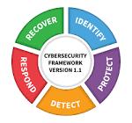
Cybersecurity Journey
MDR vendor assessment
Cybersecurity Breach Tabletop Event
2025+
Data Privacy and Management Policy
Vulnerability Management Program
SIEM (Sumo Logic) Improvements
2024
NIST Cybersecurity Framework chosen
IT Security Tools Upgrades (MS Defender for Office P1, Valimail)
Security Incident Response Policy
Cybersecurity Manager onboard
Disaster Recovery fully tested
Infrastructure Lifecycle/Asset Management in place
IT Policies updated including Cybersecurity
2023
CyberSecurity Program launch
  Quarterly Security Training & Phishing test
  Internal and External Penetration Test conducted with remediation
  1st Annual Cybersecurity Audit completed
eSentire MDR provider, new Network & Security Admin
M365 MFA, Single Sign On, InTune end point patching
CATO SASE Network and VPN globally deployed
2021 & 2022

